Slide 1
2021 VPAC Meeting VELCO Proposed Vegetation Management
2020 Veg Mgt Review
Scott Carlson
Utility Arborist/Forester

Slide 2
VELCO Cycle Map 2020 work in Blue

Slide 3
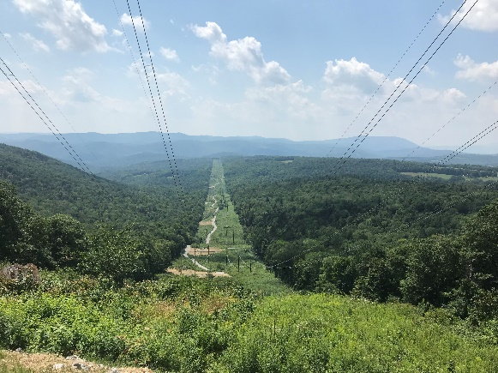
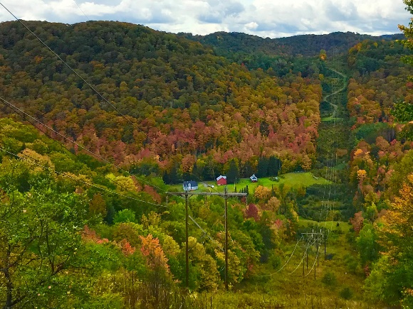
Vegetation Management Planned vs. Actual
Vegetation Management Actuals vs. Planned
 | Planned Units | Actual Units | Change | %Change
Flat Cut | 729.82 | 779.74 | 49.92 | 7%
Widen | 1.01 | 1.21 | .2 | 20%
Foliar | 1188.92 | 1119.22 | -69.7 | -6%
Mow | 259.17 | 271.72 | 12.55 | 5%
CST | 35.79 | 33.53 | -2.26 | -6%
Total | 2,974.12 | 2967.25 | -6.87 | -<1%
Danger Trees | 3,055 | 3,199 | 144 | 5%
Special trees | 218 | 221 | 3 | 1.3%

Slide 5
Herbicide Usage By Chemical

Slide 6
Herbicide Usage by Line
The average gallons per acre is mostly driven by stem densities. Over time as stem densities are reduced herbicide use should decrease.

Slide 7
Rodeo Usage by Year

Slide 8
VELCO Cycle Map 2021 Work in Red

Slide 9
2021 Scheduled Maintenance
Bennington area lines to NY and MA Borders (115kV).
Upper Valley from Wilder Dam to Barre Substation (115kV).
Granite Sub in Williamstown to Comerford Dam in Monroe, NH (230kV).
Moore Dam in Littleton, NH to Canadian Border in Derby Line (115kV).
TOTAL: 1267 acres proposed for Herbicide Treatment in 2021.

Slide 10
2021 Veg. Mgt.
Ultra Low Volume Foliar treatments with Rodeo @ 7%, Polaris @ 1% and Escort XP @ .03125% in a Thinvert carrier is proposed on approximately 1200 acres. (1267 ac. On permit application).
CST applications using Garlon 4 Ultra are proposed on approximately 8 acres.

Slide 11
Monarch Butterfly CCAA
In April of 2020 VELCO submitted an application to the University of Illinois, Chicago to enter into a conservation agreement with assurances in an effort to help protect the Monarch Butterfly.
This agreement allows for assurances of maintenance prescriptions of habitat managers (VELCO) to remain unchanged in the case that this species is listed as protected by the federal government.

Slide 12
CCAA Cont.
VELCO’s target of minimum acreage to enroll was 2,171 acres.
VELCO enrolled 12,000 acres of managed land system wide and 9,800 of those acres are managed as Monarch habitat with maintenance prescriptions of cut, mow and selective herbicide application.
75% of the VELCO system is “idle land” Monarch habitat as we are maintaining only 25% of the system annually.

